Slide 1
Outlook for 2019
Professor Steven Kyle
Cornell University
January 18, 2019

Slide 2
Grading My Predictions from Last Year
Most economists are taught to avoid naming both a number and a date
I do it anyway every year and post the results on my website (currently rendered inaccessible to me by the internet powers-that-be)
How did I do last time?

Slide 3
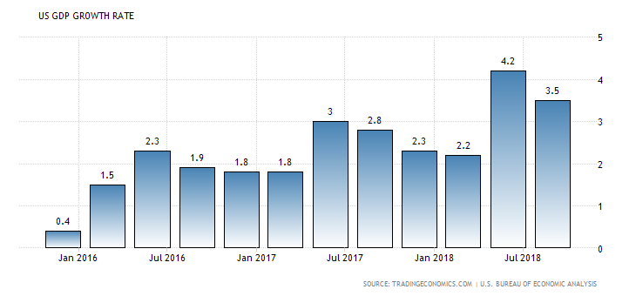
GDP
Prediction was “around 2-2.5%” – Q1 and Q4 close to that but Q2 & Q3 higher

Slide 4
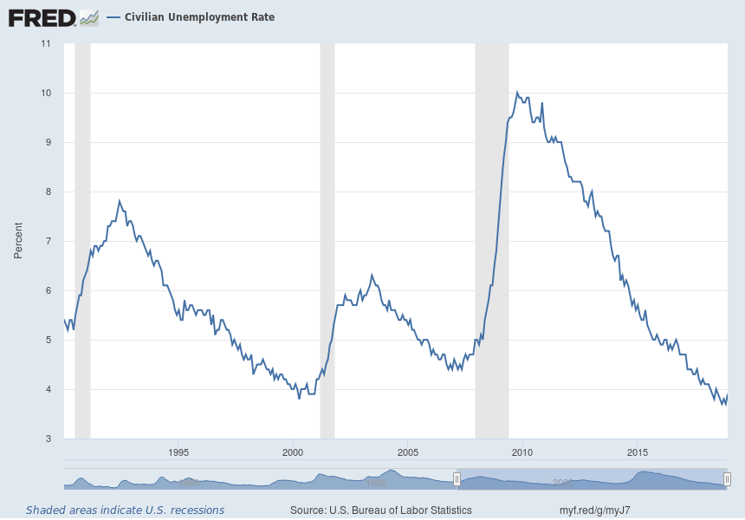
Unemployment Prediction “3.9%” Outcome – 3.9%

Slide 5
Inflation Prediction - “Will remain low but above the 2% target for the first time in 5 years”
Outcome – Exactly as predicted

Slide 6
Interest rate forecast: “2% by year end 2018” Now at 2.25%
This is the eighth increase since tightening started in late 2015

Slide 7
And My Grade for Last Year’s Prediction Is ……
I get a A- !!!!!!!!!!!!!!
I was right to count on continued growth but I underestimated just how strong growth would be
  GDP prediction definitely too low
  Unemployment prediction spot on
  Inflation prediction spot on
  Interest rate prediction spot on (may end up a bit low if Fed raises rates again this year)

Slide 8
Where We Are Now: Business Cycle Indicators
Still expanding – Now in 8th year
  Note that there is no “expected length” for a business cycle but we are definitely starting to look for a peak
3.9% unemployment now – Can’t go a lot lower than that
Housing market more or less “normal” but Fed rate increases starting to cool it off – When it peaks so will the business cycle

Slide 9
Most Recent Philadelphia Fed Coincident Index (for November)

Slide 10
Industrial Production Still Rising; Now Clearly Above Previous Peak

Slide 11
Capacity Utilization in High 70’s Range (Still below 80%)

Slide 12
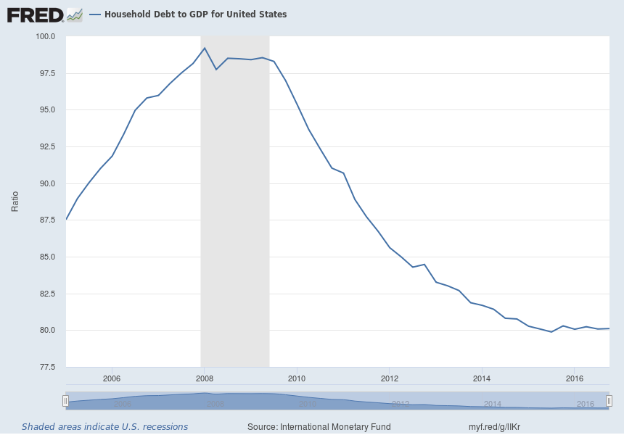
Household Debt Continues at Historically Low Levels

Slide 13
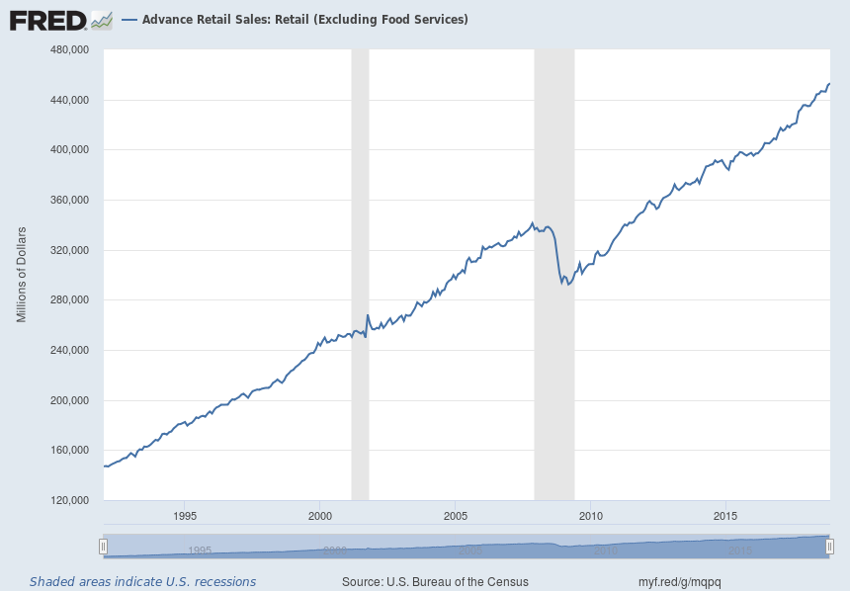
Retail Sales Continue to Rise (Remember, this is 70% of GDP)

Slide 14
Labor Market
Starting to look quite tight
More vacancies than layoffs & quits
Wage growth picking up

Slide 15
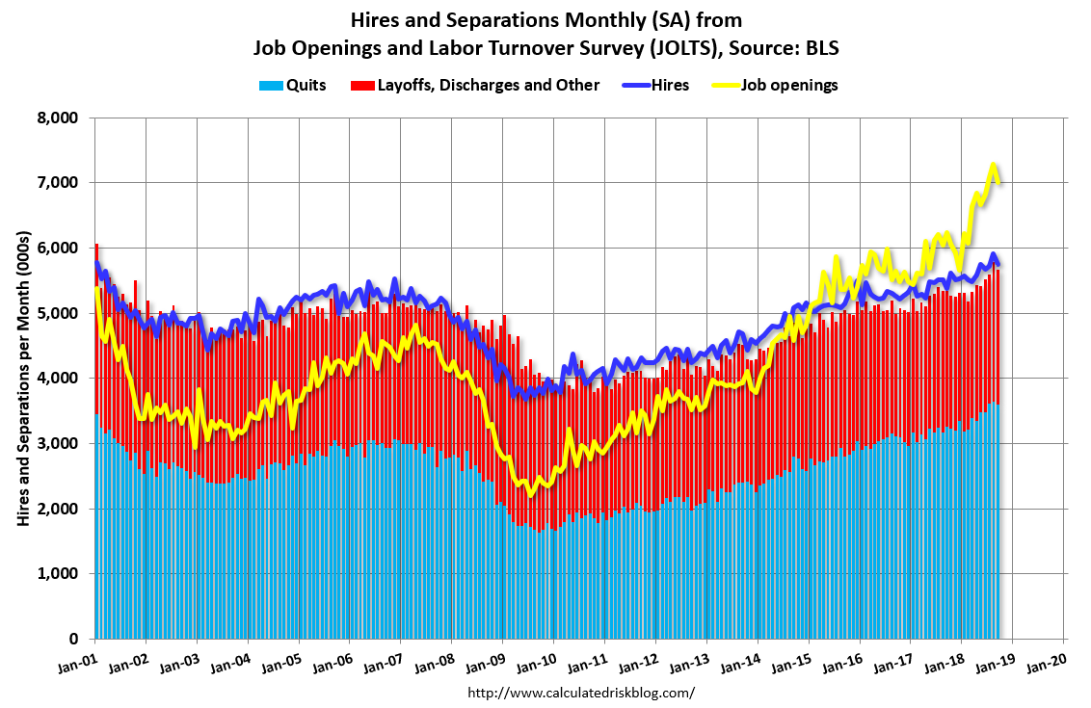
The labor market is starting to get tighter –
Job openings well above Quits and Layoffs

Slide 16
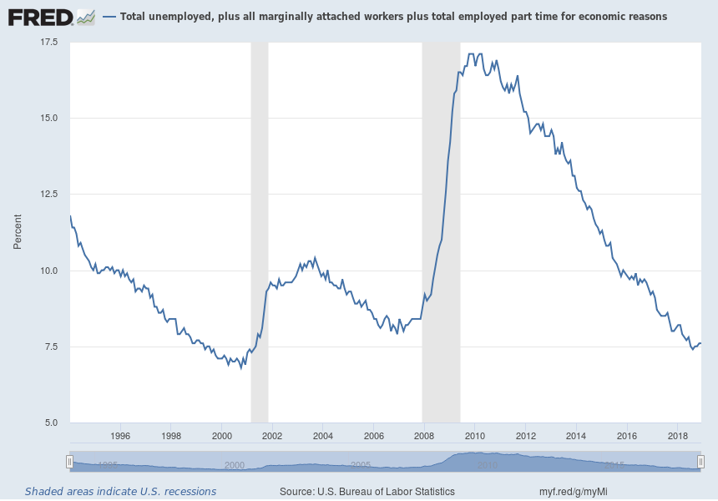
U6 (Including discouraged and part time workers)
Has been in a more or less normal range for a while; now – 7.6%
Notes:
Source:
US. Bureau of Labor Statistics
Release:
Employment Situation
The series comes from the 'Current Population Survey (Household Survey)'The source code is: LNS13327709
US. Bureau of Labor Statistics,
Total unemployed, plus all marginally attached workers plus total employed part time for economic reasons [U6RATE],
retrieved from FRED,
Federal Reserve Bank of St. Louis;
https://fred.stlouisfed.org/series/U6RATE,
November 3, 2016.

Slide 17
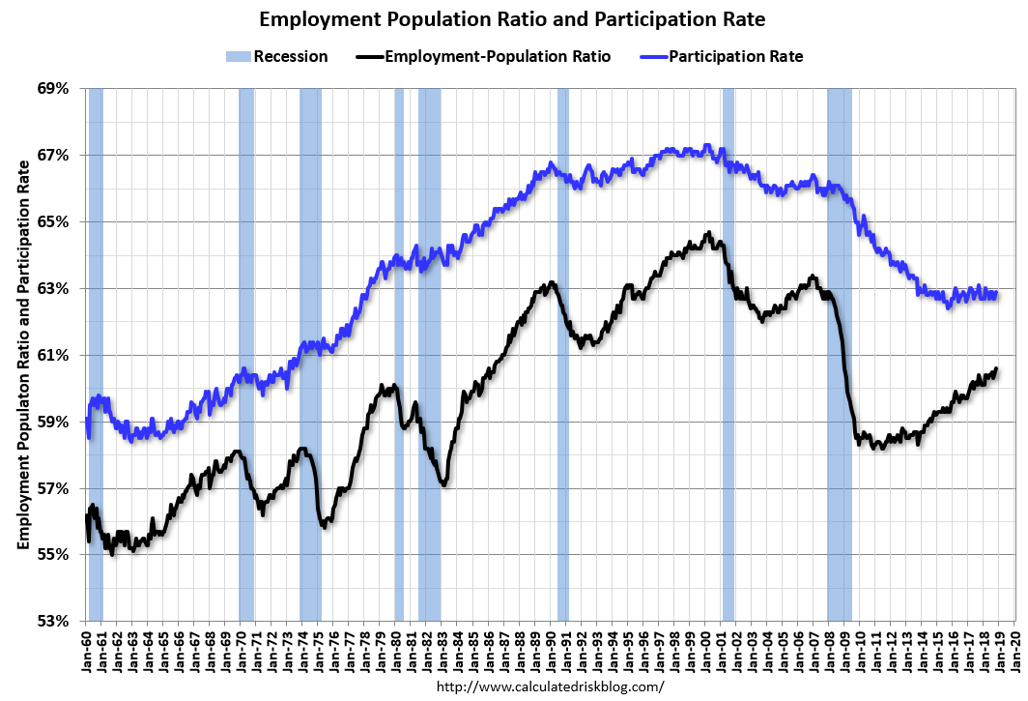
Participation Rate has levelled off but Emratio continues to rise gradually
(Yes! Workers CAN be enticed back into market if wages are high enough)

Slide 18
It is Showing in Wage Inflation Too: Not necessarily a bad thing, depending who you are…..

Slide 19
Housing Market
Backlog of foreclosed houses now gone
Nominal house prices clearly above previous peak
Real house prices getting to levels that suggest a peak soon
Price/Rent ratio also a little high
New Home Sales starting to respond to higher interest rates

Slide 20
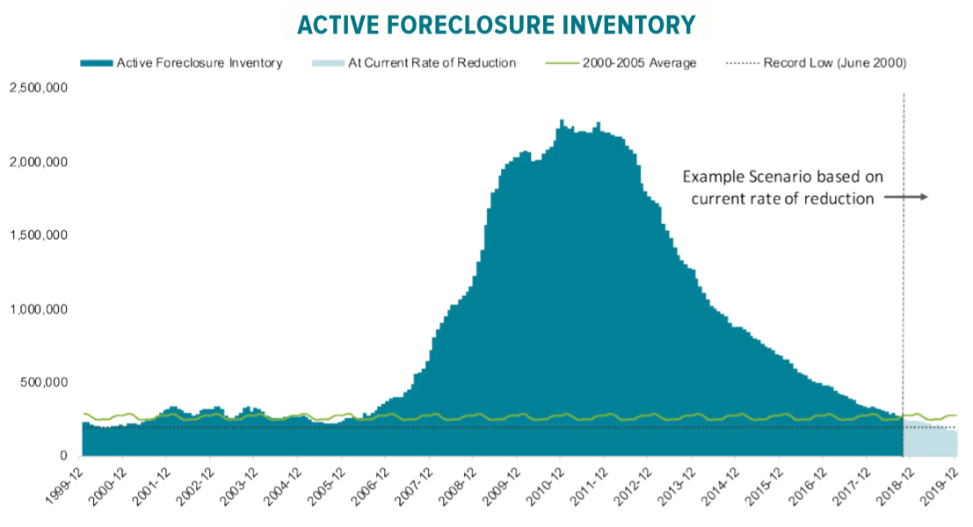
Foreclosures and Short Sales No Longer a Drag on the Market
From Mortgage Monitor

Slide 21
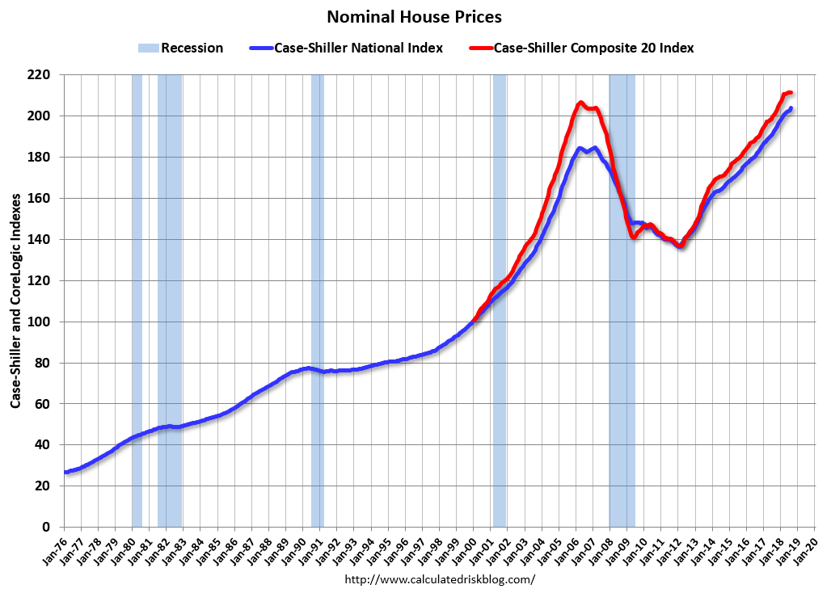

Slide 22
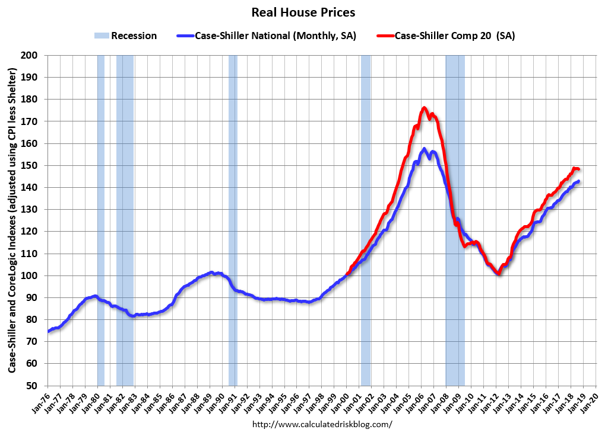

Slide 23
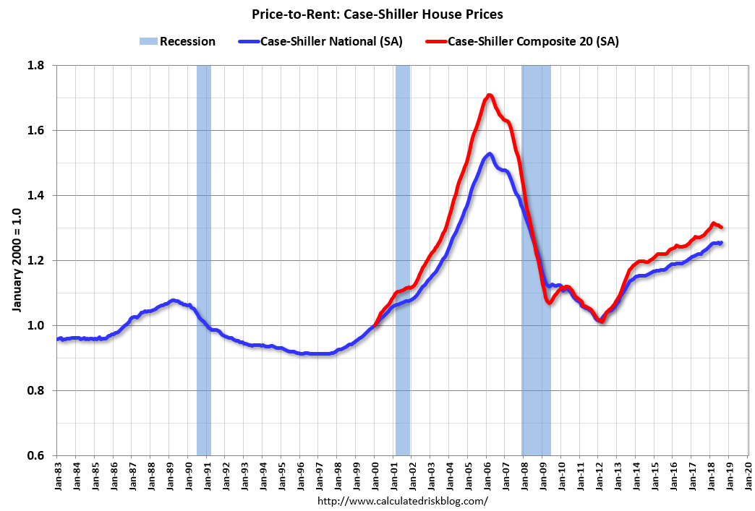

Slide 24
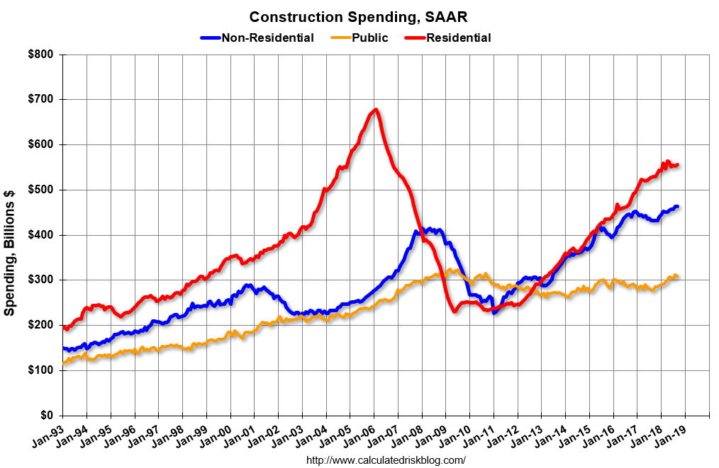
Beginning to see signs of a peak in residential housing?

Slide 25
Current Policy Stance – Monetary Policy
Fed has raised interest rates another quarter point four times in 2018
Their favorite inflation measure is now above 2% target
Wage growth above 3%
Unemployment figures now very low
A continued rising trend in interest rates will keep the dollar from falling too far against other major currencies
This will help keep inflation down
  Commodity prices too

Slide 26
Fed Statement of December 2018
“Information received since the Federal Open Market Committee met in November indicates that the labor market has continued to strengthen and that economic activity has been rising at a strong rate. Job gains have been strong, on average, in recent months, and the unemployment rate has remained low. Household spending has continued to grow strongly, while growth of business fixed investment has moderated from its rapid pace earlier in the year. On a 12-month basis, both overall inflation and inflation for items other than food and energy remain near 2 percent. Indicators of longer-term inflation expectations are little changed, on balance..”
Stock market has been volatile since then and Chinese growth below trend
Very strong employment report since then
More increases in the future – ¼% at a time unless the downturn becomes pronounced

Slide 27
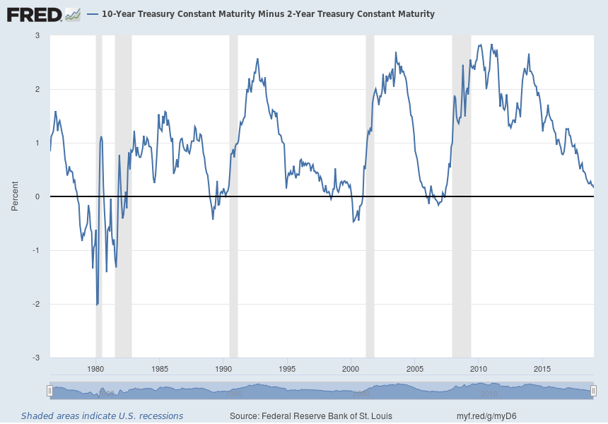
A Worrying Sign – If the Yield Curve Flattening Turns into an Inversion, Look Out!

Slide 28
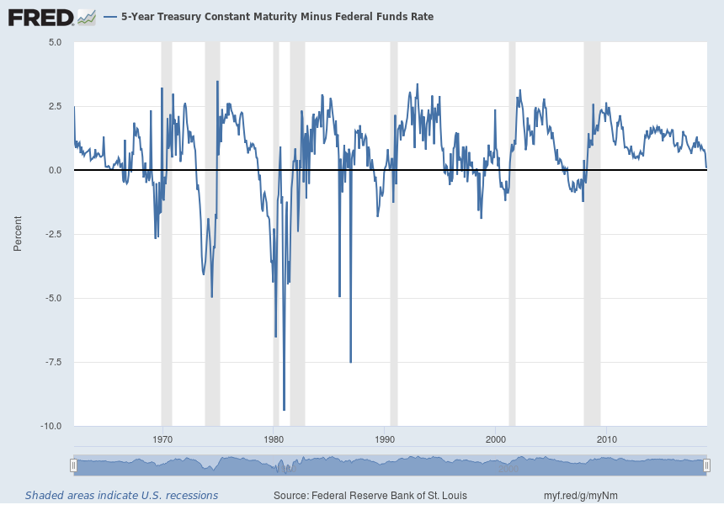
The 5 year – Fed Funds Inversion is Less Predictive but Also Worrying

Slide 29
Current Policy Stance: Fiscal Policy
Huge $1.5 trillion (over 10 years) tax cut passed: 3 main effects
  Deficit widening again
  Interest rates higher than they would have been (with consequent effects on housing market)
  Stimulus while economy is in an upswing? My Econ 101 students would fail the test if they recommended that

Slide 30
Fiscal Policy Going Forward: Can Trump and Congressional Democrats Play Nice?
Fiscal policy now has to be bipartisan
Failure of bipartisan agreement will mean paralysis and a series of continuing resolutions (at best)
New spending on infrastructure or other public investment?
  We NEED it
  Whether we get it is a political decision
The above is exactly what I said a year ago – Cited by both Trump and Dems as a possible area of agreement

Slide 31
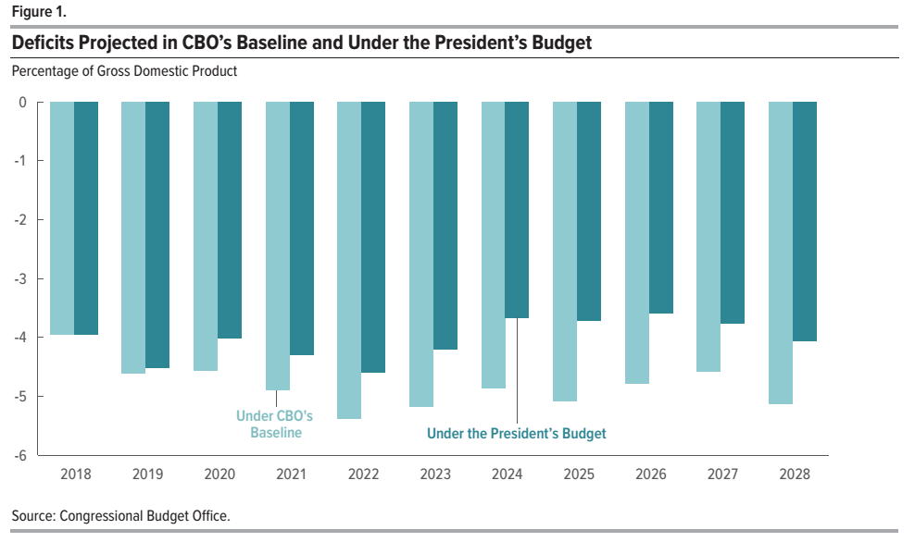
The CBO Thinks deficits will increase in the next few years

Slide 32
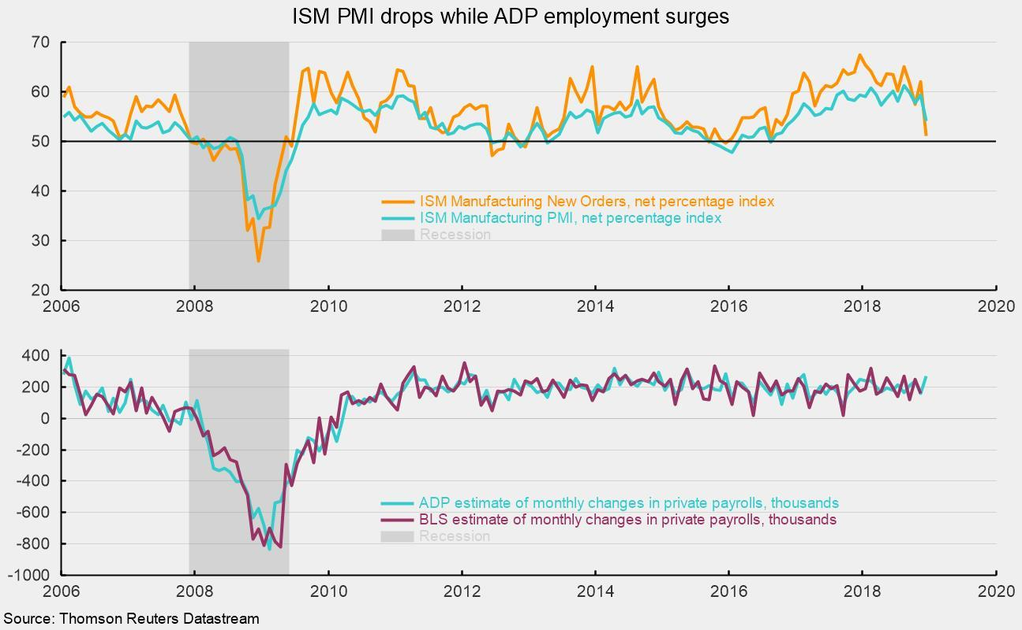
Another Troubling Development: ISM Manufacturing Index Takes a Plunge

Slide 33
And the Chaos in Washington continues …….
Are you all as tired as I am? It never stops!
Investigations plus split control of Congress likely spell policy paralysis
  Democrats want to investigate the White House
  Trump doesn’t seem to have a concrete economic policy agenda
Government shutdown over funding for the border wall
Projection/Prediction? We are in uncharted territory ……….

Slide 34
While Congress May Be Paralyzed, the Economy Still has Significant Inertia
Leading Indicators show no signs of an immediate slowdown
Nevertheless, we are likely nearing a peak in the business cycle in the near future (in the next year more than likely, but for sure within 1 ½ )
Unemployment at 3.9% is unlikely to go much lower
Inflation picking up means the Fed will continue to increase rates
This means the housing market is likely to slow down

Slide 35
Most Recent Leading Index from Philadelphia Fed (October 2018)

Slide 36
Predictions
GDP growth at around 2 - 2.5% with lower growth possible later in the year;
Unemployment – Current rate pretty nearly as low as it will go – If GDP growth levels off we could see the UE rate around 4% by a year from now
Inflation – Will remain relatively low but likely to continue above the 2%
Interest rates –– Will go up but only a ¼% at a time – 2.75-3 % by year end 2019 unless economy cools off
Fiscal Policy? The big question … I am predicting continued paralysis and short term continuing resolutions at best. Continued shutdown at worst
Exchange Rate: Higher interest rates mean a continued strong dollar which will help dampen inflation but also commodity prices

Slide 37
The Big Unknowns
Slowdown around the globe? Signs from China and EU are worrying
A constitutional crisis?
A trade war?
  It has already started. Be glad if you aren’t a soybean farmer!!
A real war?

Slide 40
Looking at the Chicago Fed’s Index of National Economic Activity we can see the sharp drop in the recession of ’09
but now looking like growth is more or less on trend (12/24/2018 figures)

